Slide 1
Inventory to GL Reconciliation
Jeff Tremaine

Slide 2
Inventory to GL Reconciliation
Whether you do it at month end or year end, it's important to reconcile your inventory sub-ledger to your inventory general ledger accounts.
We’ll show you how to export your general ledger and inventory audit reports to quickly reconcile the two in Excel.

Slide 3
Reconciliation Process
Inventory Audit Report
Run the Inventory Audit report to obtain your inventory sub-ledger and the source of truth.
Inventory General Ledger
Run the General Ledger report to obtain your inventory general ledger balances. Issues will be due to erroneous postings in the general ledger.
Excel Reconciliation
Compare the data and identify discrepancies.

Slide 4
Inventory Audit Report

Slide 5
Inventory Audit Report
Inventory report utilized to analyze inventory movements (quantity and associated costs) within a timeframe.
Report Location:
Inventory > Inventory Reports > Inventory Audit Report

Slide 6
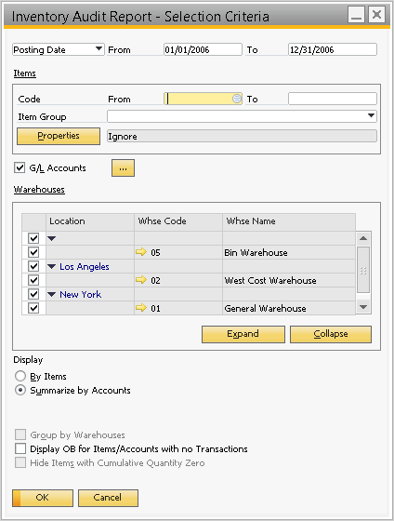
Inventory Audit Report
Set the date range (Use posting dates to align with the GL)
Run for all items
Select the same GL account used in the General Ledger report
Select all warehouses
Summarize by Accounts
Inventory Audit – Selection Criteria

Slide 7
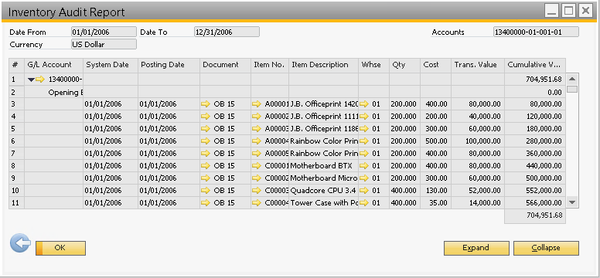
Inventory Audit Report
Inventory Audit Results

Slide 8
Inventory Audit Report
The default layout will work. The key columns are Document, Trans. Value, and Cumulative Value.
Export the results to Excel. I do not export the currency symbol if the currency is uniform (i.e. all CAD).
Copy the exported data from the Excel/Text file and into the reconciliation workbook (Inventory tab).

Slide 9
General Ledger

Slide 10
General Ledger
Accounting report utilized to analyze journal entries posted into general ledger accounts.
Report Location:
Financials > Financial Reports > Accounting > General Ledger

Slide 11
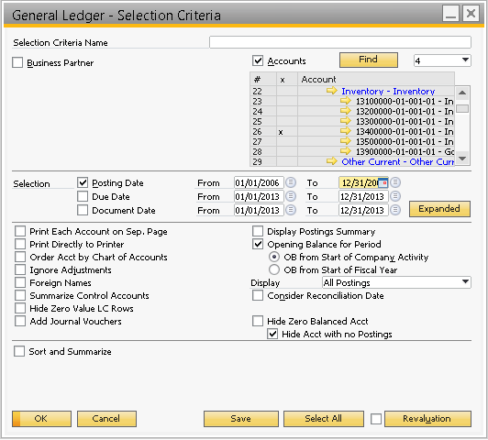
General Ledger
Un-tick Business Partner
Select the inventory GL account
Ensure Posting Date range is used and set to the required period (2006 Calendar year in this example)
Include Opening Balances from start of company activity (Balance Sheet account)
General Ledger – Selection Criteria

Slide 12
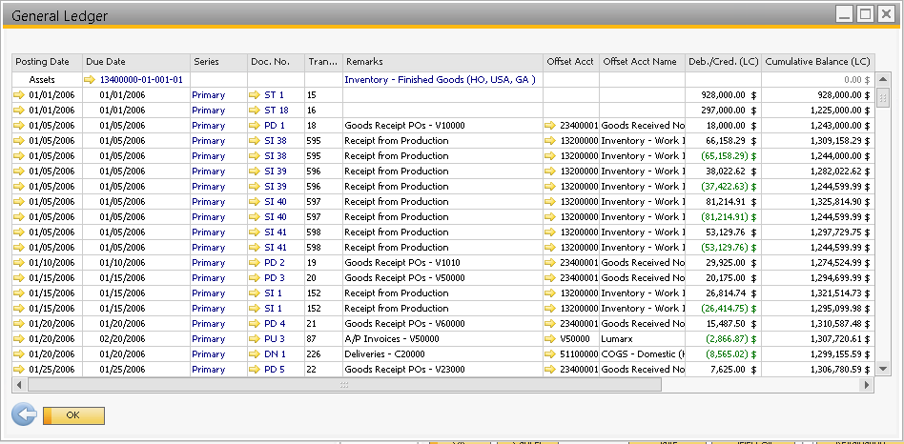
General Ledger
General Ledger Results

Slide 13
General Ledger
The default layout will work. The key columns are Doc. No., Deb./Cred. (LC), and Cumulative Balance (LC).
Export the results to Excel. I do not export the currency symbol if the currency is uniform (i.e. all CAD).
Copy the exported data from the Excel/Text file and into the reconciliation workbook (GL tab).

Slide 14
Excel Reconciliation

Slide 15
Excel Reconciliation
Four tabs:
Reconciliation – Will contain the comparison and identify variances between the GL and Inventory.
Inventory – Contains the export data from the Inventory Audit report.
GL – Contains the export data from the General Ledger report.
Unique Document Numbers – List of unique document numbers (unique key).

Slide 16
Excel Reconciliation
Key Excel Formulas and Functions:
SUMIF(Source Data Document Number Column, Rec. Tab Unique Document No., Source Data Transaction Value Column) – For the unique document number, summarizes the transaction value for each instance found in the source data document number column.
Advanced Filter (Data tab) – Utilized to identify a unique list of document numbers.

Slide 17
Excel Reconciliation
Excel Process:
Determine unique list of document numbers compiled from both the Inventory and GL tabs.
Using the SUMIF() function, retrieve the data from the inventory data and GL tabs for comparison.
Identify variances.
Eliminate valid variances due to OB (opening Balance) or ST (Stock Taking) transactions (they should net out to $0.00)
Investigate remaining variances which will be direct postings to the GL with no corresponding inventory movement.
Post adjustments.

Slide 18
Excel Demonstration

Slide 21
Thank You.

